Slide 1
Is there no end to antibiotic resistance?
CPE and C. auris
Allison McGeer

Slide 2
Objectives
To think about the relationship between IPAC and antimicrobial resistance
To consider current gaps, challenges and opportunities in CPE prevention
To introduce the new challenge - C. auris

Slide 3
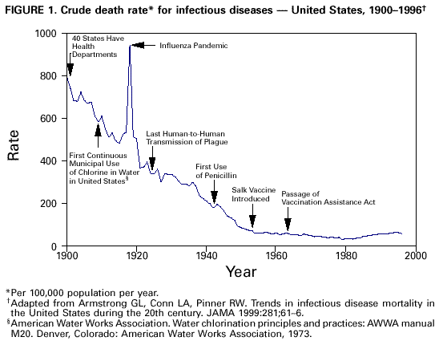

Slide 4
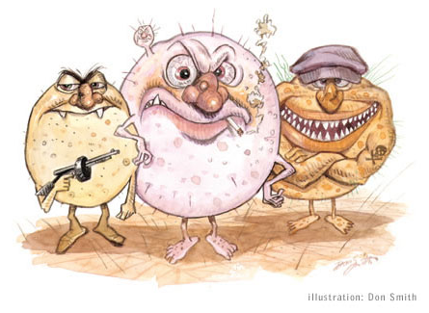
No Antimicrobials – What Would That Mean?
“If antibiotics stopped working, we would find that instead of 7% of deaths being related to infection at the moment in the developed world, it would go back up to about half (50%) of deaths.”
Dame Sally Davies, UK Chief Medical Officer (Feb 2015)
“In a world with few effective antibiotics, modern medical advances such as surgery, transplants, and chemotherapy may no longer be viable due to the threat of infection”
  US National Strategy for Combating Antibiotic-Resistant Bacteria (Sep 2014)

Slide 5
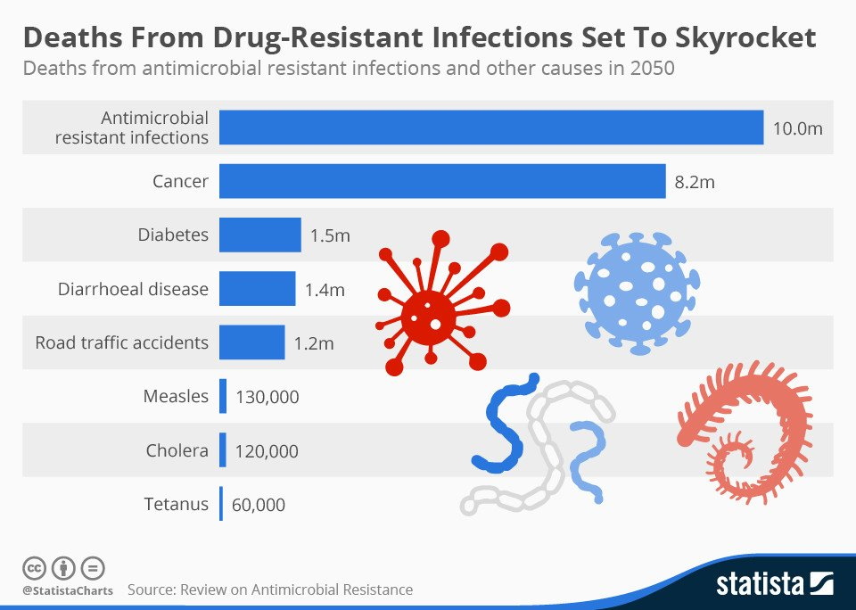

Slide 6

“Without policies to stop the ..spread of AMR, today’s already large 700,000 deaths every year would become an extremely disturbing 10 million every year, more people than currently die from cancer.”
“The cost in terms of global production between now and 2050 would be an enormous 100 trillion USD if we do not take action”
Jim O’Neill, Chair, UK review on antimicrobial resistance, 2016

Slide 7
What does antimicrobial resistance have to do with IPAC?
Opportunity:
  The most effective means of reducing the impact of antibiotic resistance is not to have infections

Slide 8
CDC: new drugs are not enough
Preventing infections, preventing the spread of disease
Tracking
Improving antibiotic prescribing and use
Developing new drugs, diagnostics and vaccines

Slide 9
What does antimicrobial resistance have to do with IPAC?
Opportunity:
  The most effective means of reducing the impact of antibiotic resistance is not to have infections
Challenge
  Preventing the spread of AROs in healthcare

Slide 10
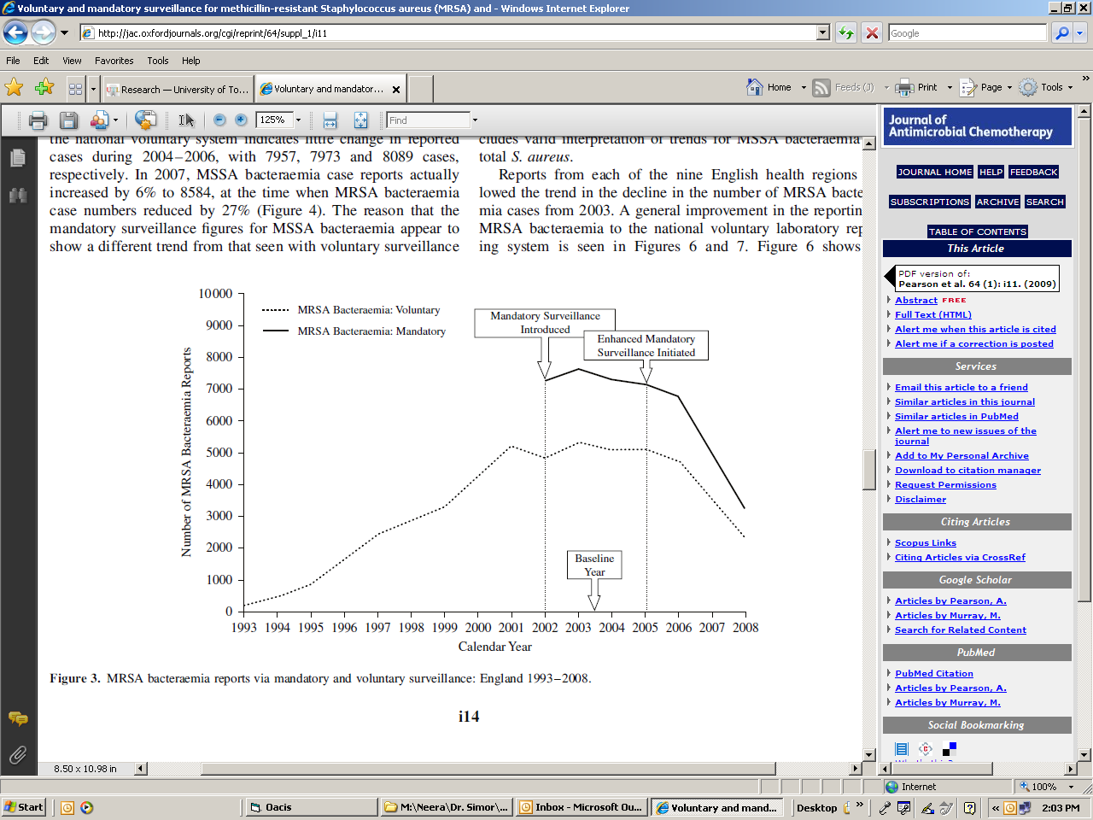
MRSA Bacteremia - England
Pearson, J Antimicrob Chemother 2009

Slide 11
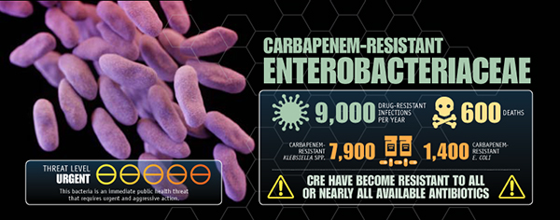

Slide 12
Definitions
CRE
CPE
CPO
CR=Carbapenem Resistant
CP=Carbapenemase Producing
E=Enterobacteriaceae
O=organism

Slide 13
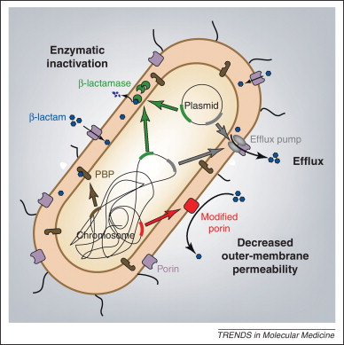

Slide 14
Incidence of detected colonization/infection by CPE, Toronto and Peel Region

Slide 15
Species and gene distribution

Slide 16
Incidence of CPE infection by CPE, Toronto and Peel Region

Slide 17
Geographic area | Clinical isolate Rate per 100,000 hospital days
Toronto/Peel | 1.0
Singapore | 7.8-10.2
Greece | 17.3
Montenegro | 9.3
Italy | 7.8
Spain | 5.9
Cyprus | 4.1
Europe | 2.5
England | 0.85
Scotland | 0.1

Slide 18
Identified risk factors, CPE colonized/infected patients, by year

Slide 19
Travel history and MDR colonization
Khawaja Clin Microbiol Infect. 2017 Feb 11.

Slide 20
Colonization pressure, Long term acute care, Chicago
Okamoto ICHE 2017

Slide 24
CPE prevalence by region, northern England
Donker, BMC Medicine 2017;15:86

Slide 25
Total expected CPE introductions to hospitals
Donker, BMC Medicine 2017;15:86

Slide 26
Fraser Health control program
Screening (by PCR)
  Med/Surg admissions: Risk based (HC out of Canada, travel to SE Asia)
  All admissions to ICUs/HAUs are screened
  Contacts of known cases screened for 21 days
  Patients awaiting screening results placed on Contact Precautions
Additional precautions
  Colonized patients placed on Enhanced Contact Precautions; patients colonized in respiratory tract with cough also on Droplet Precautions
  In a private room with dedicated toilet
  Dedicated or cohort nursing; allied staff care for patient at end of shift
    1 medical cohort each major hospital
  Dedicated equipment (cleaned or discarded)
  Daily CHG bath
  Twice daily cleaning with AHP/bleach
  Colonized patients permanently flagged “MDR”

Slide 28
Israeli control program
Mandatory reporting all cases; daily reporting of census (with check list of precautions)
Mandatory isolation colonized/infected patients; private rooms, cohort nursing
National task force, with site visits
Monthly feedback to CEO’s with performance assessment

Slide 29
Other successful control programs
Palmore TN, Clin Infect Dis 2013;57:1593-9
Enfield KP, Infect Control Hosp Epidemiol 2014;35:810-7
Hayden MK, Clin Infect Dis 2015;60:1153
Abboud CS, J Hosp Infect 2016;94:60-4
Viale P, Clin Microbiol Infect 2015;21:242-7

Slide 30
Base case: $81/QALY

Slide 32
Challenges

Slide 33
1. Choice of screening sites/ methods
Published data suggest that direct PCR from rectal swabs is equivalent to culture for detection of colonization
  Except: Singh et al. 9/66 screens negative by direct culture and positive by PCR
Fernandex DMID 2017 epub; Rezende JHI 2017;96:123; Tato JCM 2016;54:1814
Singh JCM 2012;50:2596

Slide 34


CPE+ Index samples recovered by culture
11/11
10/10
76/84
17(7)/20
26/35
Notes:
If we look closer at the PCR positive index samples,
Here is a graph depicting their recovery rate by gene. 100% of KPC and VIM identified were isolated on culture. Whereas the NDM and OXA samples were isolated at lower rates, with OXA being the most difficult to culture at 74% recovery.
For us, PCR significant increased sensitivity of detection of CPE, particularly for environmental surfaces and difficult to culture genes.
We are currently working on improving our yield in culture, which Aimee will tell you more about:
Isolates missing on culture:
Mostly OXAs – more likely to be weak carbapenamases

Slide 35
Sensitivity of groin vs. rectal vs. urine, vs. pairs compared to “gold standard” of all three positive
107/123
101/123
105/123
79/123
72/123
72/123
Notes:
This figure shows the positivity rate of urine, groin and rectal samples tested as individual samples compared to the positivity rate when tested as pairs, compared to the gold standard of all three samples being positive
Of the 303 sets of samples which have been collected so far, 123 have at least one positive anatomical site. Of these positives, all three anatomical sites have a similar positivity rate of around 60%, indicating that all three sites have comparable levels of sensitivity for CPE detection.
However, if you test any combination of the anatomical sites in pairs, the % positive rate increases to over 80%.
And only 24% of the 123 sets were positive in all three anatomical sites, which means only these 24% would be positive regardless of which single site was tested.

Slide 36
2. Sinks/Drains
Interhospital spread of NDM-7-producing Klebsiella pneumoniae belonging to ST437 in Spain Seara, Nieves et al. International Journal of Antimicrobial Agents , 2015;46:169 – 173
.
Detection and termination of an extended low-frequency hospital outbreak of GIM-1-producing Pseudomonas aeruginosa ST111 in Germany Wendel AF. Am J Infect Control. 2015;43:635-9.
Persisting transmission of carbapenemase-producing Klebsiella pneumoniae due to an environmental reservoir in a university hospital, France, 2012 to 2014. Clarivet B,
Euro Surveill. 2016; 28;21(17).

Slide 37
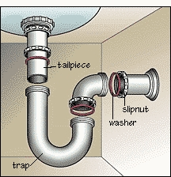
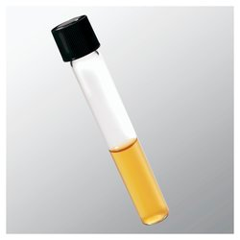
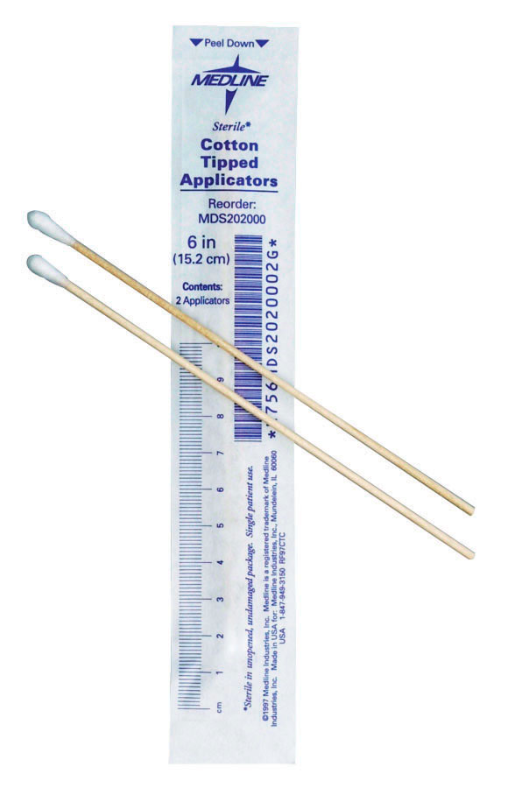
Specimen Collection & Laboratory Processing
1. Sample drain and process specimens in microbiology research laboratory.
MacConkey
with
0.125mg/L
meropenem
MacConkey
with 2mg/L
cefpodoxime
Incubate at 37°C overnight
Oxidase (-), meropenem resistant (<27mm), β-Carba (+) Enterobacteriaceae sent to the National Microbiology Laboratory to identify carbapenemase gene by PCR
2. Compare drain and patient CPE isolates by pulsed-field gel electrophoresis (PFGE).
Notes:
Collection/Processing:
-A sterile cotton swab was inserted as far into the tailpiece as possible and all sides of the tailpiece were swabbed vigorously (the tailpiece is the part just below the drain cover). Swabs were then placed in BHI broth and and transported to the microbiology lab where they were incubated overnight at 37 degrees, then planted onto a MacConkey with cefpodoxime and MacConkey with meropenem biplate. Eventually oxidase negative, meropenem resistant, Beta carba positive Enterobacteriaceae were sent to the NML to have their carbapenemase gene identified by PCR.
PFGE Comparison:
-Once we had a bunch of drain CPE isolates, we compared some of them to patient CPE isolates using PFGE

Slide 38
4.5% of Sampled Drains in Patient Rooms & Communal Shower Rooms Were CPE+
 | Total
# CPE+ inpatients since 2007 | 343
# (%) patient rooms CPE+ | 40/501 (8%)
# (%) patient room drains CPE+ | 43/1099 (4%)
# (%) hand hygiene sink drains CPE+ | 15/475 (3%)
# (%) bathroom sink drains CPE+ | 4/352 (1%)
# (%) shower drains CPE+ | 24/272 (9%)
# (%) communal shower rooms CPE+ | 10/71 (14%)
# (%) communal shower room drains CPE+ | 11/106 (10%)
# (%) sink drains CPE+ | 0/25 (0%)
# (%) shower drains CPE+ | 11/81 (14%)
343 inpatients exposed 1099 drains in 501 patient rooms and 71 communal shower rooms at 8 hospitals
54/1205 (4.5%) drains were CPE+
Notes:
We’ve completed the drain cultures at all hospitals enrolled.
The Table shows details on the types of drains that were CPE+ (so whether they were drains from hand hygiene sinks, bathroom sinks, or showers) as well as the number of hospital rooms affected – so 43 of the 54 CPE+ drains were in 40 patient rooms (or in other words, 8% of patient rooms exposed had 1 or more CPE+ drains), and 11 of the 54 CPE+ drains were in 10 communal shower rooms (or in otherwords, 14% of communal shower rooms exposed had 1 or more CPE+ drains).

Slide 39
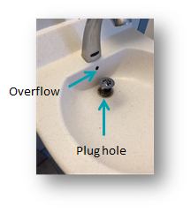
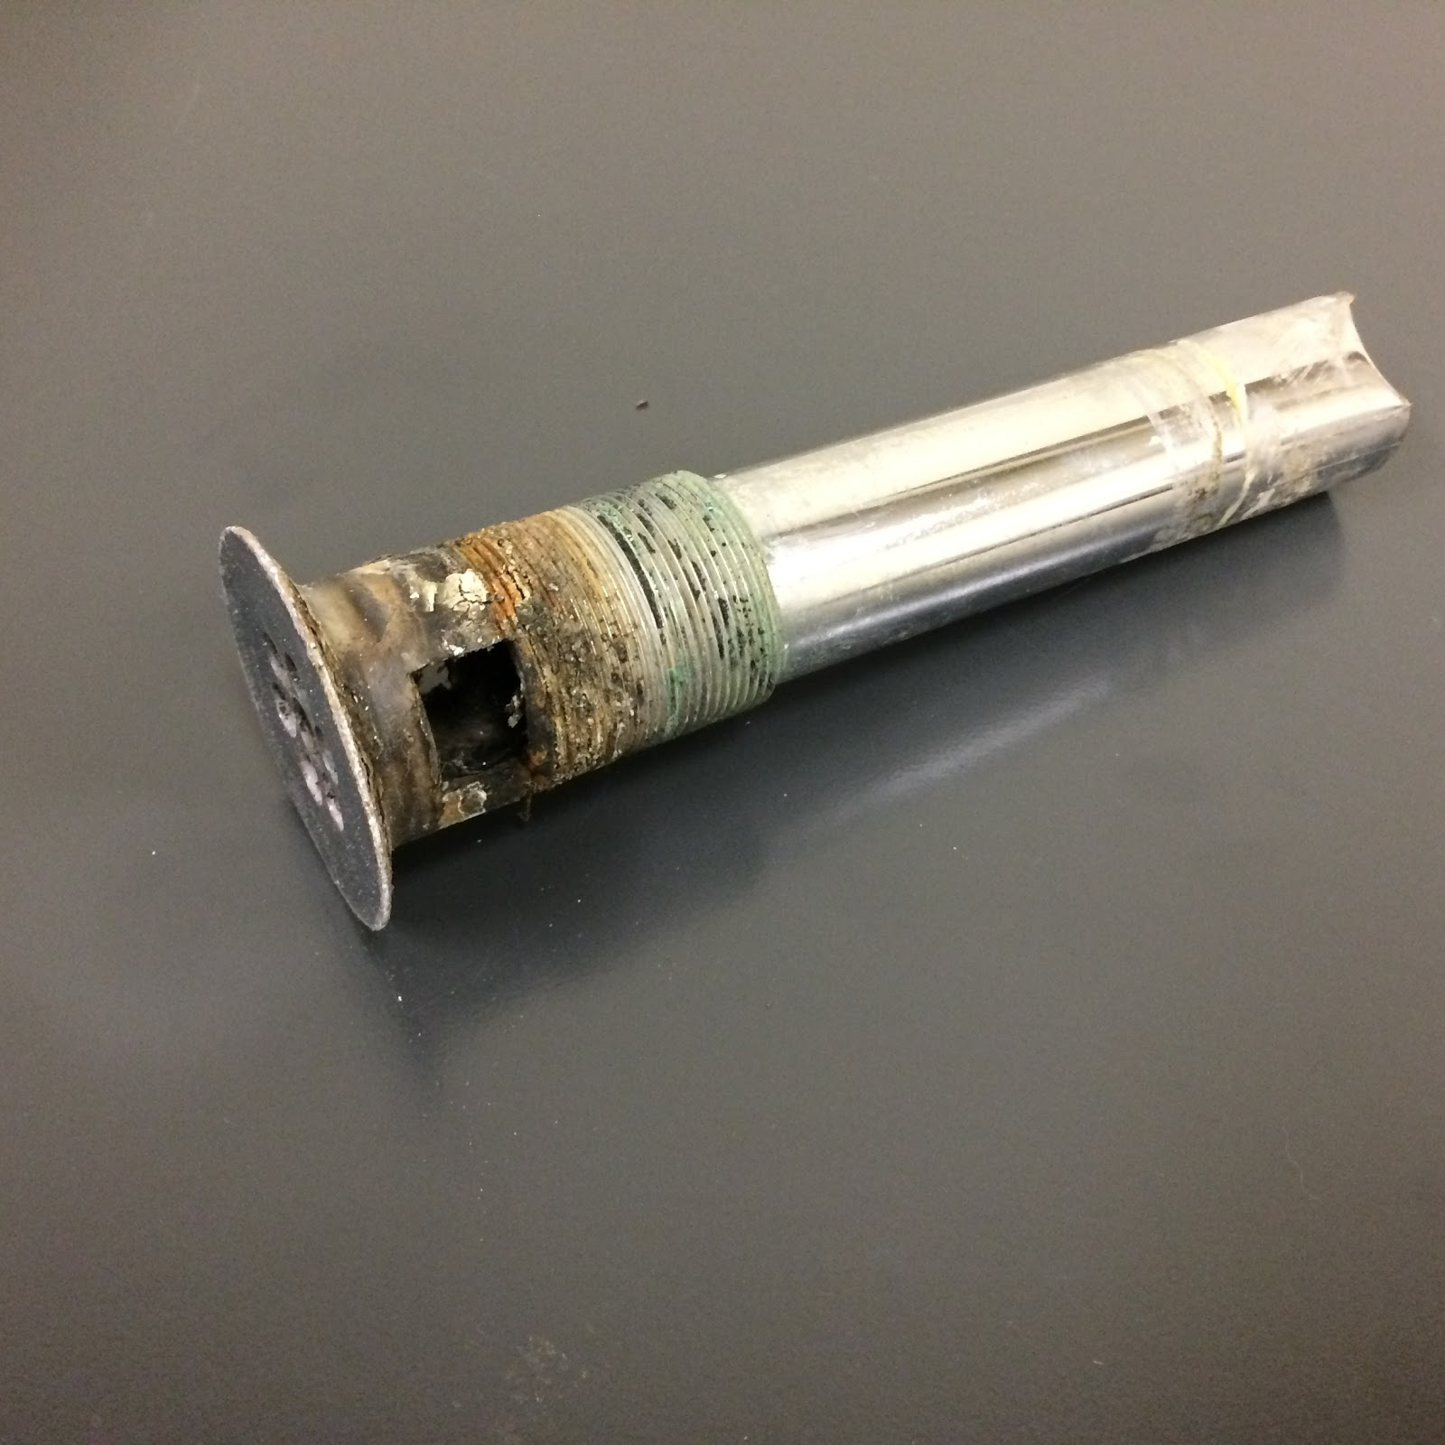
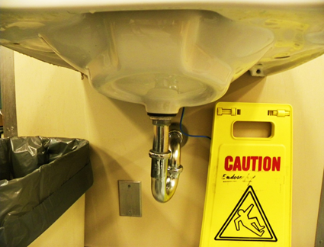
What we know about sinks/drains
Sinks of multiple different designs, including approved designs in appropriate locations have been implicated in transmission
Overflows result in persistent
contamination
Frequent chemical decontamination
usually fails (?acetic acid) –
manual cleaning of shower drains
may be effective
Changing drain to wall
works (some of the time)
Kinzy Gordon CID 2017:64;1435

Slide 40
Hospital drains
How big is the risk to patients?
Can we protect drains from CPE contamination?
Can we protect patients from colonized drains?
How do we measure drain contamination?

Slide 41
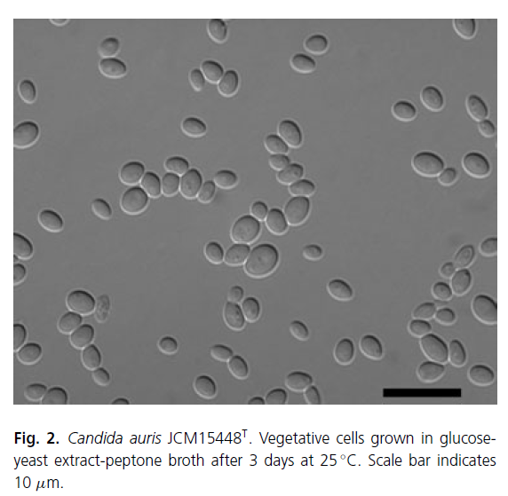
Candida auris – What is it?
(au’ris. L. gen. f. n. auris, isolated from the ear discharge of a human patient)
Isolated from a range of body sites
skin (very common)
urogenital tract (common)
respiratory tract (occasional)
invasive infections
  candidaemia
  pericarditis
  urinary tract infections
  pneumonia

Slide 42


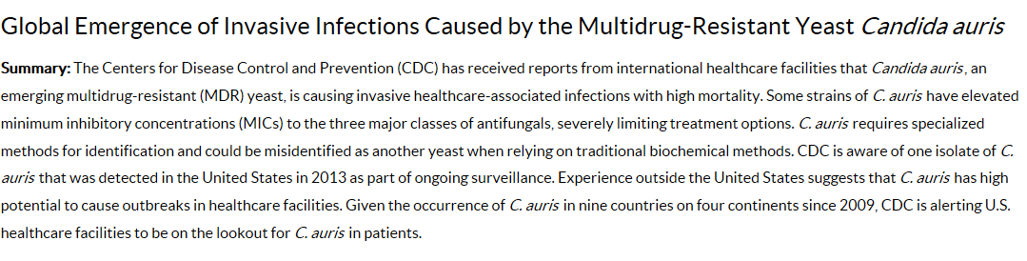
MDR
Misidentified
Highly transmissible between patients and environment
Nosocomial infections/outbreaks
High mortality
Widespread

Slide 43
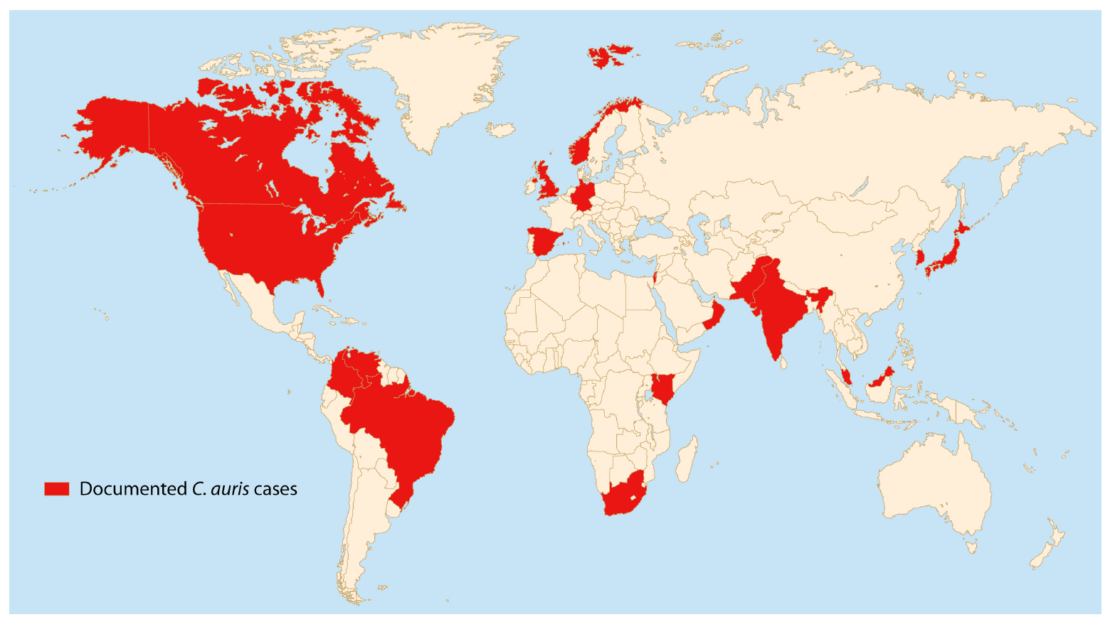
2017
Countries that have reported detection of C. auris
Jeffery-Smith A et al. 2018. Candida auris: a review of the literature. Clin Microbiol Rev 31:e00029-17

Slide 44
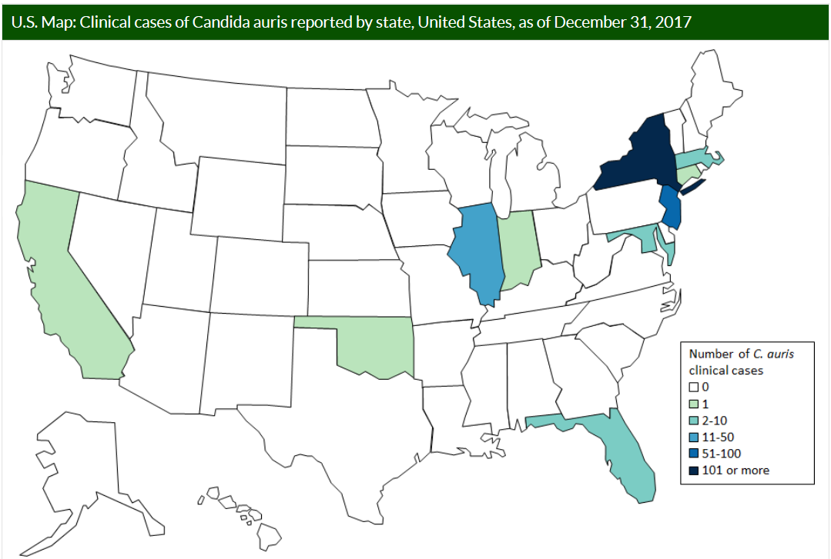
The American experience
2013 -2016: 7 cases
Current case count
(as of January 31, 2018):
- 215 confirmed cases
- 347 colonized patients
U.S. hospitals identified C. auris in 5 patients who were recently hospitalized in other countries (India, Pakistan, South Africa, and Venezuela).
Most cases resulted from local transmission of C. auris following previous introduction from other countries.
In the US:
90% resistant to fluconazole
30% resistant to amphotericin B
5% resistant to echinocandins
https://www.cdc.gov/fungal/diseases/candidiasis/tracking-c-auris.html

Slide 45
CDC IPAC Recommendations
Standard and Contact Precautions. C. auris positive patients in a single-patient room, use Standard and Contact Precautions.
  as long as the person is colonized with C. auris.
Hand Hygiene. Emphasize adherence to hand hygiene.
Environmental Disinfection. Cleaning and disinfecting patient care environment (daily and terminal cleaning)
  EPA-registered hospital-grade disinfectant effective against Clostridium difficile spores
Screening. Screen contacts of newly identified cases to identify C. auris colonization.
  Patients colonized with C. auris should be managed using the same infection control measures as for patients with C. auris infection
  Screening for C. auris should be done using a composite swab of the patient’s axilla and groin.
https://www.cdc.gov/fungal/diseases/candidiasis/c-auris-infection-control.html#contacts

Slide 46
In Sum
We need to start thinking about home grown risks in CPE control programs across Ontario
  As hospitals, we need to be held accountable for transmission to patients
For CPE control, IPAC programs will need microbiology support for environmental cultures and best patient screening
C. auris is likely to be the next ARO
Antimicrobial resistance is never boring

