Slide 1
Adult Vaccination
Dr. Sumon Chakrabarti MD FRCPC DTM&H
Trillium Health Partners
April 6, 2017
IPAC Conference

Slide 2
Objectives
Distinguishing and outlining importance of adult vaccination
Discussion of four major adult vaccines
Touch on current mumps / measles outbreak
Show a few terrible nerdy jokes

Slide 3
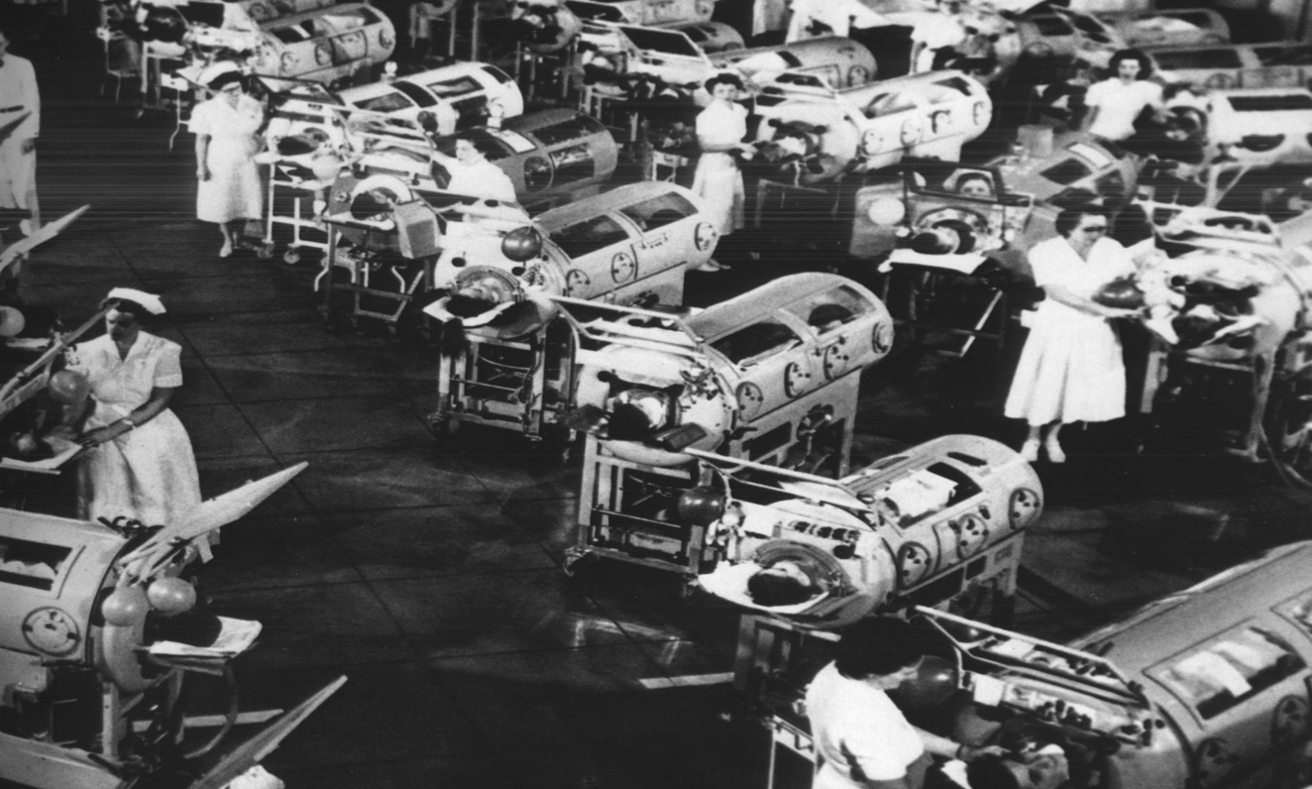
“Immunization has saved and improved more lives in the past century than any other medical advancement known to humankind!”

Slide 4
Ten Great Public Health Achievements 1900 - 1999
Vaccination
Motor vehicle safety
Safer workplaces
Control of infectious diseases
Decline in deaths from coronary heart disease and stroke
Safer and healthier foods
Healthier mothers and babies
Family planning
Fluoridation of drinking water
Recognition of tobacco use as a health hazard
MMWR, December 24, 1999

Slide 5
Adult Vaccines ahead
Pneumococcus
Varicella Zoster
Hepatitis A & B Vaccines
Measles / Mumps / Rubella

Slide 6
Vaccines are for adults too!
“In the United States, between 50,000 and 90,000 adults die each year from pneumococcal disease, influenza, and hepatitis B .
From Reid KC, Grizzard TA, Poland GA. Mayo Clin Proc. 1999;74:377–384
Notes:
According to one publication, “In the United States, between 50,000 and 90,000 adults die each year from pneumococcal disease, influenza, and hepatitis B infection. In contrast, approximately 300 to 500 children die annually of vaccine-preventable diseases.”¹

Slide 7
Vaccines & Older Adults
Childhood vaccinations prevent illness in children, but…
Most adult vaccines do not prevent illness but lessen the severity of infection.
Aw, D., et al, Immunosenescence: emerging challenges for an ageing population. Immunology 2007. 120, 435–446.

Slide 9
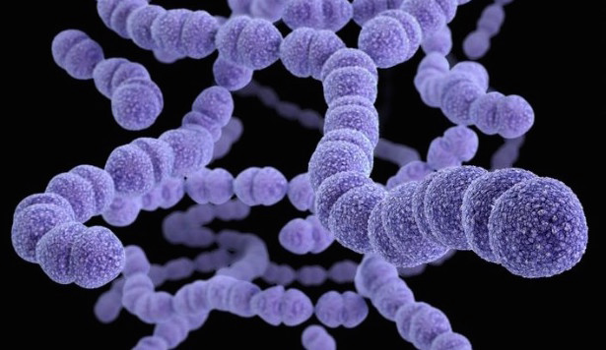
Pneumococcus

Slide 10
Pneumococcus
Streptococcus pneumoniae
Affects both children & adults
Most common cause Pneumonia & meningitis
NB in chronic lung Dz, asplenia, HIV

Slide 11
Pneumococcal Vaccines
90 serotypes
Vaccine designed to cover most common
PCV7, PCV13 (Prevenar conjugated)
PPSV23 (Pneumovax Polysacc)

Slide 12
Pneumovax (PPSV23)
Polysaccharide (Not conjugated)
Covers 23-serotypes
Not as immunogenic
Immunity wanes easily

Slide 13
Prevenar (PCV13)
Diphtheria protein attached (conjugated)
Pro: Makes vaccine more immunogenic
Pro: More durable immunity
Con: fewer serotypes included

Slide 14
Previous Recommendation
Pneumococcal vaccine in adults is for those >65y or with high risk immune compromising conditions

Slide 15
Adult Pneumococcal vaccine: What are the high risk conditions?
Immunosuppress
HIV.
Malignancy
Renal disease
Asplenia
Smokers
Diabetes mellitus
Sickle cell disease
Coeliac disease
Nephrotic syndrome
CVD & COPD
Cirrhosis
Alcoholism
2 doses

Slide 16
The problem with Pneumovax...

Slide 17
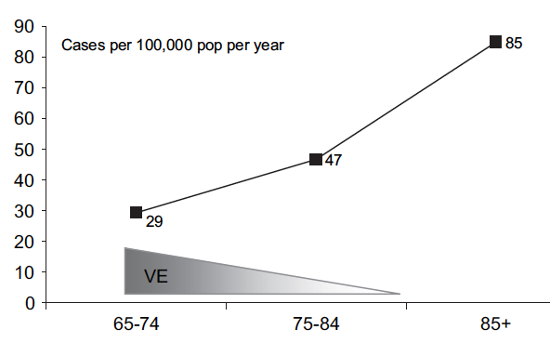
Pneumovax efficacy drops sharply with age…
Vaccine Efficacy

Slide 18
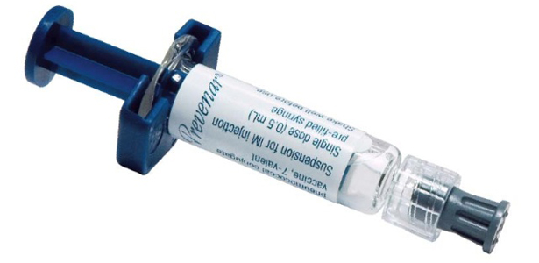
Is there any way to boost efficacy of Pneumovax?
18

Slide 19
conjugate vs polysaccharide vaccines
property | polysacc. | conjug.
T-cell dependent response | - | +
immune memory | - | +
hyporesponsiveness | + | -
booster effect | - | +
persistence of protection | - | +
carriage reduction | - | +
herd immunity | - | +

Slide 20
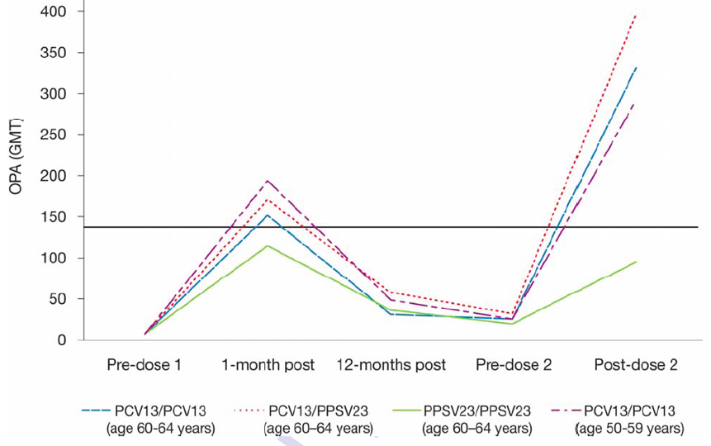
Sequential pneumococcal vaccines
PCV13 +PPSV23
1
2
PPSV23+PPSV23
CID 2012 May 9.
Notes:
Opsonizing pneumoococcal antibody

Slide 21
Always give PCV13 first; follow with PPSV23
≥8 weeks later
65
If already received PPSV23, wait 1 year and give PCV13

Slide 22
Take home points
Pneumococcus causes significant disease in both adults & children
Pneumovax suboptimal especially for elderly (polysaccharide)
Giving conjugate vaccine Prevenar13 prior to Pneumovax boosts and increases its efficacy
22

Slide 24
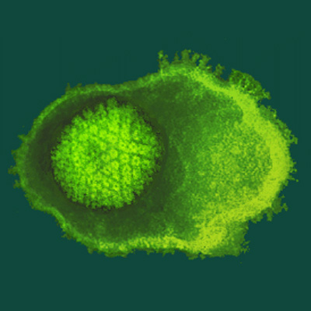
Varicella-Zoster

Slide 25
Varicella-Zoster
Causative agent of chickenpox & shingles
Herpes Virus group
Establishes latency after infection

Slide 27
Shingles risk factors
Advancing age:
- Decreased CMI with age
Immunosuppression:
- HIV-AIDS
- Organ transplants
- Malignancy
- Imuunosuppressive therapy

Slide 28
Aging, Natural Boosters and Zoster Risk
Varicella Exposure
Silent reactivation?
VZV
T-cells
Zoster Threshold
Varicella
Herpes Zoster
Age
Arvin A, NEJM 352:2266, 2005
Notes:
Varicella is the primary infection caused by VZV, and its resolution is associated
with the induction of VZV-specific memory T cells (black line).
Memory immunity to VZV may be boosted periodically by exposure to varicella or silent
reactivation from latency (red peaks).
VZV-specific memory T cells decline with age.
The decline below a threshold (dashed orange line) correlates with an
increased risk of zoster.
The occurrence of zoster, in turn, is associated with an increase in VZV-specific T cells.
The administration of zoster vaccine to older persons may prevent VZV-specific T cells from dropping below the
threshold for zoster occurrence (dashed green line).

Slide 29
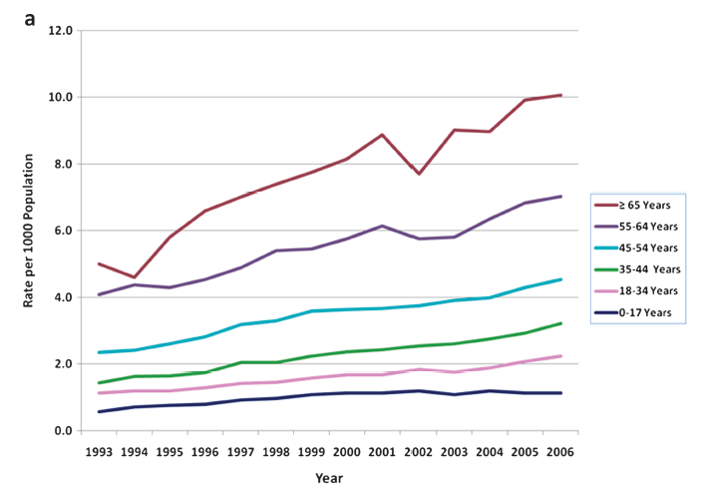
Herpes zoster USA 1993-2006
Clinical Infectious Diseases 2011;52(3):332–340
Females > males
29

Slide 30
Shingles: Canadian epidemiology
30% lifetime risk *
15% of cases Post-herpetic neuralgia (PHN) of whom 70% have moderate to severe pain *
* Brisson M. CIC 2004

Slide 32
Treatment of Herpes Zoster
Antivirals(given early):
- modestly shortens the rash
- do NOT prevent PHN
Corticosteroids:
- decreases severity of acute pain
- do NOT prevent PHN
Once zoster develops treatment does not prevent PHN
32

Slide 33
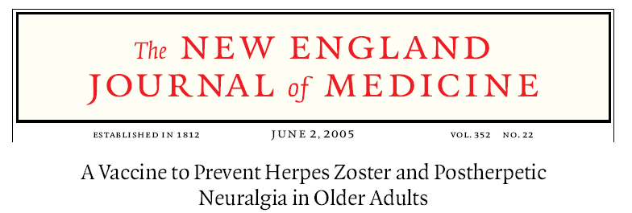
38,548 60-70 year olds
N= 50

Slide 34
The Shingles Prevention Study Vaccine Efficacy: Zoster Incidence by age
Efficacy | 51.3% | 63.9% | 37.6%
14
Vaccine
12
Placebo
10
Incidence of HZ
8
6
*
4
2
0
All
60-69 yr
≥70 yr
*P <0.001
Adapted from Oxman M et al. N Engl J Med. 2005;352:2271-2284.

Slide 35
The Shingles Prevention Study Vaccine Efficacy: PHN Incidence by age
Efficacy | 66.5% | 65.7% | 66.8%
2.5
Vaccine
2.0
Placebo
1.5
Incidence of PHN
1.0
0.5
*
0.0
All Subjects
60-69 yr
≥70 yr
Adapted from Oxman M et al. N Engl J Med. 2005;352:2271-2284.
*P <0.001

Slide 36
We know the vaccine works. Who should get it?

Slide 37
Zoster Vaccine Recommendations
Use ZV in adults ≥60
ZV can be used in adults 50-69
Wait 1yr to give ZV following episode of zoster
https://www.canada.ca/en/public-health/services/publications/healthy-living/update-use-herpes-zoster-vaccine.html#usage
37

Slide 38
Take home points
Shingles affects 30% of Canadians in lifetime
15% of Shingles cases develop PHN
70% of PHN has mod-severe pain
Zoster vaccine reduces risk of zoster and of PHN.
38

Slide 40
Hepatitis A / B Vaccination & Travel

Slide 41
Hep A Profile
Heparna virus, genus picorna
Present worldwide, higher incidence in developing world
Fecal oral transmission
Acute illness, no chronic carrier state

Slide 42
Clinical Spectrum
Mild to subclinical illness in children
Adults: n/v/d, RUQ pain, jaundice
“stomach flu” w/o jaundice
Fulminant liver failure

Slide 43
Hep B Profile
Hepadna virus, oncovirus
Present worldwide, higher incidence in developing world
Transmission bodily fluids (vertical, sexual, blood transfusion etc.)
Both acute / chronic disease present

Slide 44
Clinical Spectrum
Children more likely to develop chronic carriage
Asymptomatic → fulminant liver failure
Cirrhosis
**Hepatocellular carcinoma

Slide 45
Hepatitis A/B Vaccination

Slide 46
Hepatitis A Vaccine – Fact Sheet
Multiple monovalent preparations
Combo preparations exist (+Hep B, +typhoid)
Protection occurs with 1 shot
Booster at 6-12 months

Slide 47
Hepatitis A Vaccine – Fact Sheet
Should be given to ALL travelers, consider for all adults
Typhoid often given with Hep A with tropical travel
Give to all people with chronic liver disease

Slide 48
Hepatitis B Vaccine – Fact Sheet
3 injection regimen (0, 3, 6 months), now routine
Accelerated regimen (3 weeks**)
Protection exists even with 1 or 2 shots

Slide 49
Hepatitis B Vaccine – Fact Sheet
Recommend routinely for all Candians
Use travel as an opportunity for someone who does not have vaccine.
Should also be given to ALL travelers

Slide 50
Take home points
Hep A & B potential infections for all adults (esp. travel to developing country)
Use travel consult as opportunity to address all vaccines (esp. in adults)
Recommend ALL travelers be vaccinated against Hep A / B
50

Slide 52
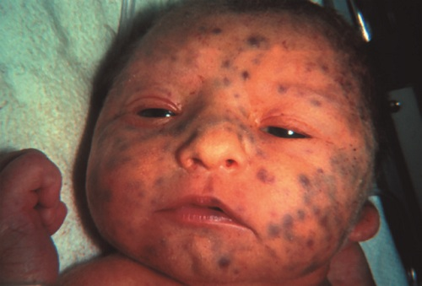
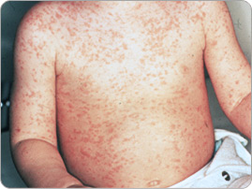
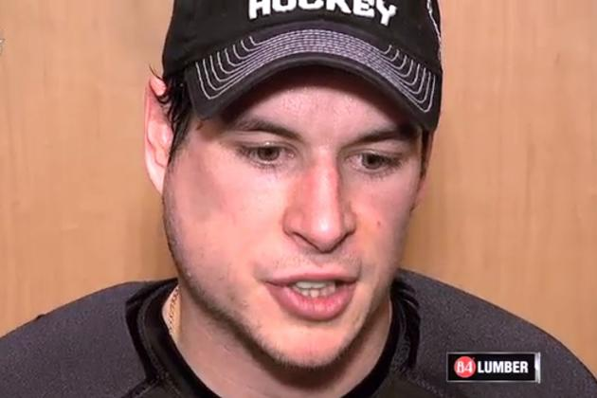
Measles / Mumps / Rubella
http://www.phac-aspc.gc.ca/im/vpd-mev/mumps-oreillons/professionals-professionnels-eng.php

Slide 53
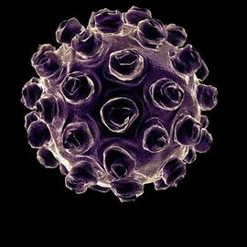
Measles / Mumps / Rubella
Three viral infections whose incidence dropped dramatically with vaccination
All 3 diseases have severe complications which is rationale for vaccinating
Currently 3 in 1 vaccine is used MMR or MMRV

Slide 54
Measles
http://www.phac-aspc.gc.ca/im/vpd-mev/mumps-oreillons/professionals-professionnels-eng.php

Slide 55
Measles
Extremely contagious (90% attack rate)
Persists in envinronment
Viral prodrome then conjunctivitis, rash
Complications
http://www.phac-aspc.gc.ca/im/vpd-mev/mumps-oreillons/professionals-professionnels-eng.php

Slide 56
Clinical Manifestations

Slide 57
Clinical Manifestations

Slide 58
Measles Complications
Deafness
Encephalitis
Myocarditis
Pneumonitis
Subacute Sclerosing Panencephalitis

Slide 59
Mumps
http://www.phac-aspc.gc.ca/im/vpd-mev/mumps-oreillons/professionals-professionnels-eng.php

Slide 60
Mumps
Contagious, spread through saliva, resp. droplets
Viral prodrome, parotitis most common
Complications relatively common
http://www.phac-aspc.gc.ca/im/vpd-mev/mumps-oreillons/professionals-professionnels-eng.php

Slide 61
Mumps Complications
Encephalitis
Orchitis / Oophritis → infertility
Myocarditis
Pneumonitis

Slide 62
Current Outbreak in Toronto
http://www.phac-aspc.gc.ca/im/vpd-mev/mumps-oreillons/professionals-professionnels-eng.php

Slide 63
Rubella
http://www.phac-aspc.gc.ca/im/vpd-mev/mumps-oreillons/professionals-professionnels-eng.php

Slide 64
Rubella
Attacks all ages, most severe with congenital infection
http://www.phac-aspc.gc.ca/im/vpd-mev/mumps-oreillons/professionals-professionnels-eng.php

Slide 65
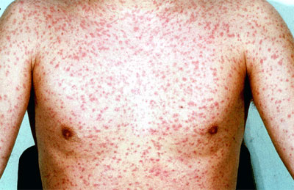
Rubella (German Measles)
Attacks all ages, most severe with congenital infection
Rash, arthritis, l/n
Spread by droplet aerosols, oral secretions
http://www.phac-aspc.gc.ca/im/vpd-mev/mumps-oreillons/professionals-professionnels-eng.php

Slide 66
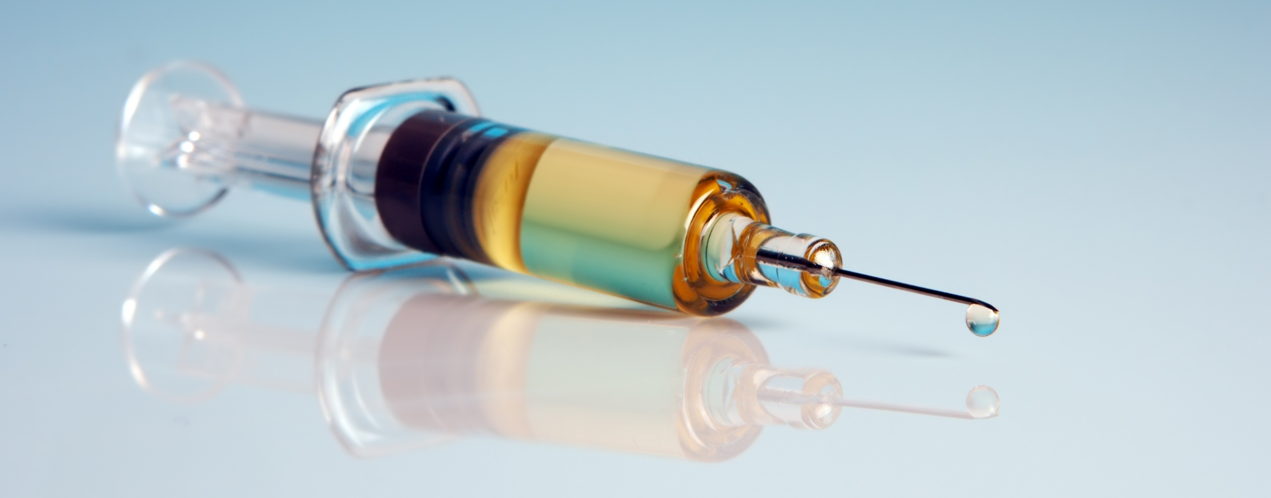
MMR(V) Vaccination

Slide 67
MMR(V) Vaccination
Introduced in Canada in 1969
Live virus vaccine (all elements)
1970-1996 1 dose given @ 12-15 months
Now booster given on school entrance

Slide 68
MMR(V) Vaccination
Very effective for Measles & Rubella ≥95%
Very effective for Mumps, but less so. ~85-90%

Slide 69
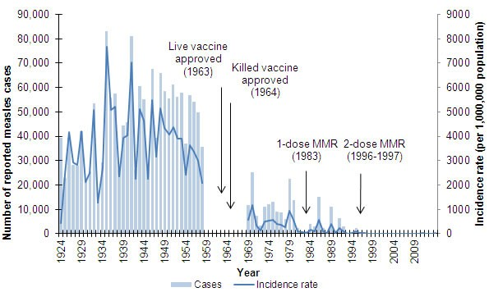
Measles Incidence

Slide 70
MMR(V) Vaccination
33,000 Measles Cases / Year (Pre vaccine)
~200 Cases / Year now

Slide 71
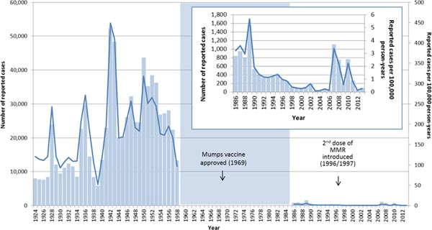
Mumps Incidence

Slide 73
MMR(V) Vaccination
WHO SHOULD GET VACCINATED?

Slide 74
MMR(V) Vaccination
All children
2 doses (~1 & 5 years of age)
Unimmunized (Catch up)
2 doses ≥1 month apart
Travellers to developing world
1 or 2 doses depending on vaccination history

Slide 75
Individuals born 1970 - 1996
Received only 1 dose MMR
Outbreaks often associated with this group
Titres not always indicative of immunity (esp mumps)

Slide 76
Individuals born 1970 - 1996
Currently 2nd dose given to:
Military personnel
Health Care workers
Highschool & Uni students
*outbreak settings

Slide 77
High Profile Outbreaks

Slide 78
Current Outbreak in West Toronto
Exposure certain bars in the area
Age range ~25-45
Corresponds with cohort given 1 dose of MMR
Importance of herd immunity
http://www.phac-aspc.gc.ca/im/vpd-mev/mumps-oreillons/professionals-professionnels-eng.php

Slide 79
Should we be giving a second shot to all individuals born between 1970-1996?

Slide 80
Things to Consider...
Single dose recipients → outbreaks
Vaccine not 100% efficacious (esp. mumps)
Herd immunity affected by 1970-96 cohort?
http://www.phac-aspc.gc.ca/publicat/ccdr-rmtc/07vol33/acs-08/index-eng.php

Slide 81
Things to Consider...
Positive Serology not always correlate with immunity (esp. mumps)
NACI/PHAC discourages serology to indicate immunity
*HCWs / Pregnant women
http://www.phac-aspc.gc.ca/publicat/ccdr-rmtc/07vol33/acs-08/index-eng.php
https://www.canada.ca/en/public-health/services/publications/healthy-living/canadian-immunization-guide-part-4-active-vaccines/page-14-mumps-vaccine.html#p4c13a7

Slide 82
Public Health Agency of Canada
Serologic testing for measles, mumps, rubella and varicella antibodies post-immunization with MMRV vaccine is unnecessary and not recommended, either before, between or after the primary two-dose series.
http://www.phac-aspc.gc.ca/publicat/ccdr-rmtc/10vol36/acs-9/index-eng.php#n9

Slide 83
Center for Disease Control (CDC)
The presence of mumps-specific IgG, as detected using a serologic assay (EIA or IFA), does not necessarily predict the presence of neutralizing antibodies or protection from mumps disease
https://www.cdc.gov/mumps/lab/overview-serology.html

Slide 84
Recommend all should receive 2nd dose of MMR regardless of serology

Slide 85
Take home points MMR
Live vaccine, contraindicated pregnancy / immune compromise
Cohort born 1970-1996 only had 1 routine MMR, may contribute to outbreaks
Measles / Mumps serology does not always correlate w/ immunity

Slide 86
Take home points MMR
Consider completing 2 doses of MMR for all

Slide 88
OVERALL SUMMARY

Slide 89
Adult Vaccines
Childhood vaccinations prevent illness in children
Adult vaccines meant to lessen the severity of infection.
Consider vaccination status in all adults as you would a child

Slide 90
THANK YOU!!

