Slide 1
The Scoop on Poop: 21st Century Look at an 18th Century Problem
Updated 20180412 1245!
Jim Gauthier MLT, CIC
Senior Clinical Advisor
Infection Prevention

Slide 2
Disclaimer
Jim is employed by Diversey. His expenses to attend this meeting (travel, accommodation, and salary) are paid by this company.

Slide 3
Objectives
Review mode of transmission and portal of entry related to multi-drug resistant organisms (MDRO)
Discuss areas in healthcare that need more attention
Propose ideas for discussion

Slide 4
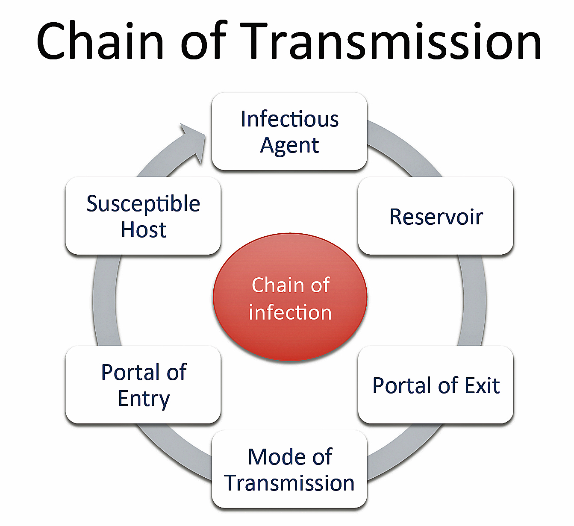
http://diseasedetectives.wikia.com/wiki/Chain_of_Transmission
Notes:
4

Slide 5
Infectious Agent
Vancomycin Resistant Enterococci (VRE)
Extended Spectrum Beta Lactamase (ESBL)
Carbapenemase-producing Enterobacteriaceae (CPE)
Carbapenemase-producing Organisms (CPO)
Clostridium difficile (CD)
  Not truly an MDRO

Slide 6
Infectious Agent
Methicillin Resistant Staphylococcus aureus
  Yes, that bug… (Boyce 2007)
Ebola
  Yes, I know it is not an MDRO by definition
  Norovirus
  Rotavirus

Slide 7
http://diseasedetectives.wikia.com/wiki/Chain_of_Transmission
Notes:
Or the Chain of Infection – Depends on where you come from!

Slide 8
Reservoir
Feces
fe‧ces fi siz/ [fee-seez] –noun (used with a plural verb )
  1. Waste matter discharged from the intestines through the anus; excrement.
  2. Also, especially British, faeces.
    Origin 1425-75; late middle English from Latin faecēs – grounds, dregs, sediment
  *www.dictionary.com Dictionary.com unabridged V1.0.1

Slide 9
Reservoir
Urine
  Colonization common
  Especially elderly patients
  Catheterized patients

Slide 10
Reservoir
Sputum
  Common in elderly, intubated (Garcia 2005)
  Not applicable to this presentation
Sink Drains
  Beyond this presentation

Slide 11
http://diseasedetectives.wikia.com/wiki/Chain_of_Transmission

Slide 12
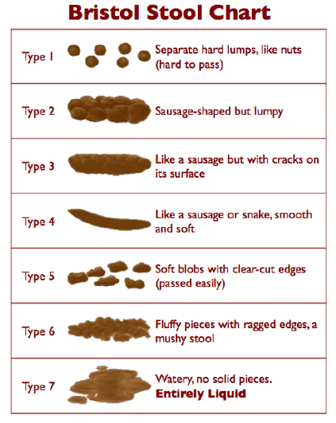
Portal of Exit
Defecation
  Formed, soft, loose
  www.continence.org.au
  (O’Donnell 1990)
Urination

Slide 13
http://diseasedetectives.wikia.com/wiki/Chain_of_Transmission
Notes:
Or the Chain of Infection – Depends on where you come from!

Slide 14
Mode of Transmission
Equipment
  Bedpans, commode buckets, urinals, High Touch surfaces (Overbed tables, bed rails), toilet high touch surfaces
Hands
  Staff
  Patients
  Sink Drains
  Aerosols
Notes:
Will talk about aerosols later

Slide 15
http://diseasedetectives.wikia.com/wiki/Chain_of_Transmission

Slide 16

Portal of Entry
Rectum, mouth, non-intact skin
Fecal – oral
  Who puts feces into the patient’s mouth or rectum?
  Rectum – endoscopes, gloved hands
  Mouth – endoscopes, hands

Slide 17
Portal of Entry
“Hepatitis A is usually spread through having oral contact with items contaminated with hepatitis A, for example, through ingesting food or drinks contaminated by infected feces”
ProMed 20180112

Slide 18
http://diseasedetectives.wikia.com/wiki/Chain_of_Transmission

Slide 19
Susceptible Host
Our patients
CDI
  Proton pump inhibitors, antibiotics, hemodialysis, HIV, numerous hospital admissions (Bengualid 2011)
CRE
  International travel (Tängdén 2010)
  Unrecognized colonized patient (Borgia 2012)
Notes:
Borgia: 5 patient spread. “Although standard infection-control methods were able to limit the spread of this organism in the hospital setting

Slide 20
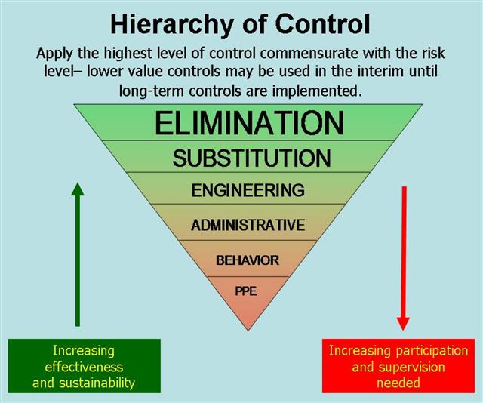
Control Measures
www.qualitysystems.com

Slide 21
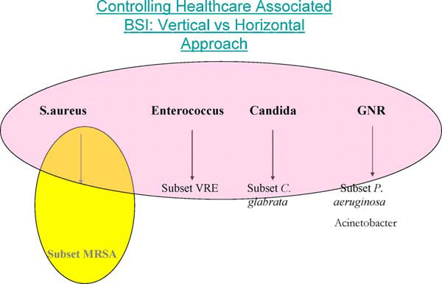
Horizontal vs Vertical Infection Control
Wenzel 2010

Slide 22
Horizontal
Reduce rates of all infections for all pathogens
Hand hygiene program
Decolonization therapies (Chlorhexidine bathing)
Board to ward (Nat Audit Office 2009)
Antibiotic Stewardship Programs
Cleaning and disinfection

Slide 23
Vertical
Focus on a single pathogen or anatomic site
Pathogen specific
  MRSA
  VRE
  ESBL
  CRE
  C. difficile
  Acinetobacter
  Candida auris

Slide 24
Semmelweis
Death by Group A Streptococcal puerperal sepsis
  Screen for Group A only?
  Only use an agent effective against gram positive cocci?
  Only wash hands if in morgue?

Slide 25


Slide 26
WARNING!!
This patient has:
  Skin!
  Feces!
  Mucous Membranes!
PERFORM HAND HYGIENE AFTER CONTACT WITH THIS PATIENT OR THEIR ENVIRONMENT!

Slide 27
VRE in the Environment
Grabsch 2006
Colonized and past colonized VRE patients
Structured exam, hemodialysis sessions
Chairs positive in 36% outpatient, 58% hemodialysis
Couch positive 48% OP, 42% radiology,
Notes:
OP sat in a chair, participated in a 15-minute discussion with the HCW, had blood pressure measured, got undressed to underwear, put on a clean hospital gown, and lay on an examination couch for approximately 5 minutes, during which time the HCW examined the patient and obtained a rectal swab (while wearing gloves)
radiology procedure: the patient entered the study room, got undressed to underwear, put on a routine patient gown, and lay on the radiology trolley for 15 minutes, during which time the HCW measured the patient’s blood pressure. The patient then got off the trolley and got dressed, shook the HCW’s hand, and departed. The HCW then washed his or her hands with water and 4% chlorhexidine solution. The total duration of the procedure was approximately 15 minutes

Slide 28
VRE – How Much?
Ray (2002) - 12 of 13 had greater than 4log VRE per gram (mean 7.5 log)
Mayer (2003) - The mean density of these specimens was 7.5 log10 cfu/g of stool (range: 3.7-9.2 log) for the patients who were continent and 6.2 log10 cfu/g of stool (range: 3.4-8.9 log) for those who were incontinent

Slide 29
NDM-1 Environment
Walsh 2011- New Delhi
12 of 171 seepage samples grew
2 of 50 water samples grew
11 species in which NDM-1 not previously reported
Some resistance to meropenem seen in isolates

Slide 30
Survival - CRE
Havill 2014
Looked at K. pneumoniae and C. freundii
Can be shed into the environment and survive
Because in GI tract, could be shed with high inoculum
 | Water | Trypticase Soy Broth
K. pneumoniae | 19 days | 40 days
C. freundii | 12 days | 40 days

Slide 31
C. difficile Colonization
Alasmari 2014 14% on admission
  Toxigenic, no relation to previous admission
Galdys 2014 Review article
  Strong evidence suggests that CD-colonized individuals are a reservoir for CD infection
Donskey 2015 Review article
  As above
  Sporicidal in all rooms has potential to reduce transmission
Notes:
Galdys – no mention of diarrhea other than review articles where diarrhea is defined as 6 or more BM in 36 hours

Slide 32
C. difficile Colonization
Longtin 2016 4.8% of admission were carriers. Isolation of carriers reduced overall HAI with CD

Slide 33
MRSA diarrhea
Stools for CD testing cultured for MRSA
  Case: Diarrhea and MRSA colonization of stool (pure to heavy growth)
  Control: MRSA + patients, negative stool colonization with MRSA
10 surfaces in patient’s room cultured
Notes:
Case patients had heavy (3 to 4) and nearly pure growth of MRSA on a screening culture of a recent stool sample
8 case patients and 6 control patients were identified. There were 163 other patients with varying amounts of MRSA growth in their stool cultures during this period, but none of these patients had nearly pure and heavy (ie, 3 to 4) growth of MRSA in their stool cultures.

Slide 34
MRSA diarrhea
59% of case surfaces contaminated
23% of control surfaces contaminated
Most commonly bedside rails, blood pressure cuffs, television remote controls, and toilet seats
Specimens were found to contain approximately 10⁷-10⁹ colony-forming units (cfu) per gram of stool
  Boyce 2007

Slide 35
Ebola
2-4 litres of liquid stool per day
  Lyon 2014

Slide 37
Control Measures
www.qualitysystems.com

Slide 38
Suggestions – Clean!
  Nseir 2011
  Acquisition if in bed from previous patient
Siani 2011
  Wipes moved spores around
  Issue with “sporicidal” claims
Sattar 2013
  Need better control of wipe use and testing
Loo 2015
Clean environment and patient’s hands

Slide 39
Suggestions – Clean!
Zoutman 2013
  40% of ICP’s felt hospital was NOT clean enough
  Frequent consultation between IPAC and Environmental Services before cleaning changes – lower CDI rates

Slide 40
Suggestions – Clean!
Zoutman 2014
Less than 50% of EVS managers felt they had enough staff
Over 1/3 did no auditing

Slide 41
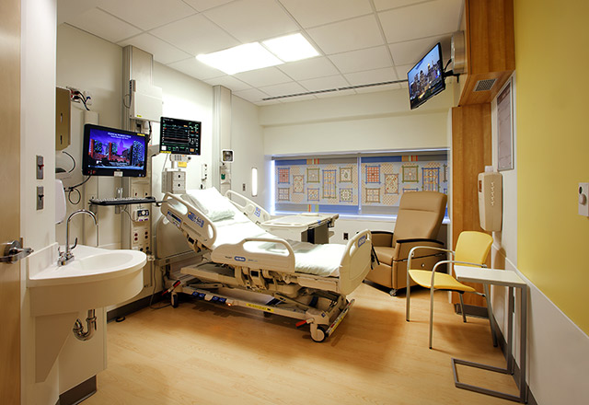
The Patient’s Environment
EVS Cleans 1x per day…
What happens the other 23.5 hrs?

Slide 42
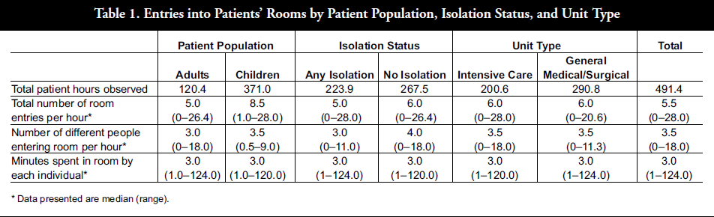
Patient Room Entries
Between 5 AM and 8 PM, (ICU and Med/Surg Unit)
Number of room entries = 5.5/hour (28 max)
Number of different staff entering room = 3.5/hour (18 max)
Number of people in room during waking hours
= 15 hrs * 5.5 /hr = 82.5 people
Cohen 2012

Slide 43
Surface Contact
Huslage and Rutala (2010) studied HTS in an ICU and a general med-surg unit.
In the ICU (contacts per interaction):
  Bedrails = 7.8
  Bed surface = 6
  Supply cart = 4

Slide 44
Surface Contact
In the Med-Surg unit (contact per interaction)
  Bedrails = 3.1
  Over-bed table = 1.6
  IV pump = 1.4
  Bed surface = 1.3
Average surfaces per interaction:
  ICU = 44, Med-Surg = 15

Slide 45
More Math!
Room entries per hour = 5.5
Bedrail contacts per hour = 17.1 (5.5 x 3.1)
Bedrail contacts per 15 hour patient ‘awake’ day = 256
Number of times per day bedrail is disinfected by EVS = 1
  Probability of EVS disinfecting the bedrail = ~50%

Slide 46
?255?

Slide 47
ICT Feb 2018 – 24 Hour ICU
Patient (850)
WOW (634)
Bedrail (375)
IV pump (326)
Bed Surface (302)
Overbed Table (223)
Vitals Machines (213)
Wall Shelf (110)
Door (90)
In room Computer (78)
Jinadatha BMC Infect Dis 2017

Slide 48
Math!
Number of times per day bedrail is disinfected by the clinical staff = ? (probably zero)
  Probability of Clinical staff performing hand hygiene = 40%

Slide 49
6 Moments of Environmental Disinfection (6MED)
Before placing a food tray on an over-bed table
After any procedure involving feces or respiratory secretions within the patient bed space
Before/after any aseptic practice (wounds, lines, etc.)
After patient bathing (within bed space)
After assistance with productive cough or vomiting
Any time surfaces are visibly soiled

Slide 50
It is everyone’s job to disinfect, but it is not everyone’s job to disinfect everything
every time!

Slide 51
Why do We Need to do This?
Bed Rail as HTS
Bhalla (VRE), Boyce 1994 (VRE), Bonten (VRE), Ray (VRE), Duckro (VRE), Hayden (VRE), Mayer (VRE), Hota (VRE), Sehulster (HTS), Rock (KPC), Rosa (CR-Ab), Calfee (MRSA), Anderson (Bioburden), Sample (VRE), Hess (MDRO), Thom (MDR-Ab), Boyce 2007 (MRSA), Adams (Bio), Attaway (Bio), Choi (CR-Ab), Yui (CDI)
Notes:
20

Slide 52
Why do We Need to do This?
Overbed table as HTS:
Bhalla (VRE, St. aureus, Gm neg bacilli, CD), Boyce 1994 (VRE), Boyce 2007 (MRSA), Hota (VRE) , Enfield (A. baumannii), Calfee (MRSA), Hess (MRSA, MDR-Ab), Dancer 2008 (bioburden) , Dancer 2009 (MSSA, MRSA), Adams (bioburden), Yui (CDI)

Slide 53
Why do We Need to do This?
Two body substances that are predominately organisms
  Feces – 1x10¹² per gram dry weight (Kelly)
  Saliva – 1x10⁸ per mL (Lamont)

Slide 54
Moment 1 – Food Tray
Overbed table listed as HTS or contaminated (see previous slide!)
We all know what goes on an overbed table
None of us eat in our bathrooms!

Slide 55
Moment 2 – Feces/Suctioning
Mayer 2003 - VRE
Continent – average 3.2X10⁷ colony-forming unit/g of stool (5x10³-1.6x10⁹)
Incontinent 1.6x10⁶ colony-forming unit/g of stool (range: 2.3x10³-7.9x10⁸)
1,600,000,000!
790,000,000!

Slide 56
Moment 2 – Feces/Suctioning
Ray 2002 - VRE
  13 patients (8 NH,5 Hosp) – 12 had >4log VRE per g stool
  Mean of 7.5 log or ~32,000,000 per g stool!
Boyce 2007 - MRSA
  If present in 4+ -> 10⁷-10⁹ Colony-Forming Units (cfu) per gram of stool

Slide 57
Moment 2 – Feces/Suctioning
Site | Known + CD Patient |  | No Known + CD Patient
 | After Routine | After Terminal | After Routine | After Terminal
Bedrails | 50% | 11.8% | 7.4% | 4.1%
Bedside Table | 57.1% | 22.2% | 7.5% | 5.9%
Bed Controls | 42.9% | 17.6% | 3.7% | 4.1%
Yui 2017

Slide 58
Moment 2 – Feces/Suctioning
Rock: CRE – spread linked to caring for a patient with trach or ET
Morgan (2010): MDR-Ab: “…care or use of endotracheal tube or tracheostomy site…”
Morgan (2012): “… the respiratory tract is often heavily colonized with MDR bacteria and contact with respiratory equipment may pose a particular risk…”

Slide 59
Moment 3 – Wounds
Rock – CRE: “…factors associated with HCW contamination … providing wound care (4 of 11 contacts resulted in contamination; P = .05)…”
Morgan- MDR-Ab: “ …wound dressing…”
Sergent – bioburden: “…contamination in the hospital environment is frequent during the dressing of colonized wounds with tissue loss…”
Notes:
Sergent: “However, other measures should be proposed even if they do not yet correspond to usual hospital practices: first, the room should be cleaned not before dressing a colonized wound, but after.”

Slide 60
Moment 4 – Basin Bathing
Johnson – basin mean aerobic colony count of 91657, median 1150. Reference (Shannon – not available) that showed bath water had >10⁵ cfu/mL
Rose - “Standard plate count bacteria ranged from 10⁵ to 10¹⁰ (cfu) per 100 ml for shower and bath water, and an average of 10⁴ to 10⁶ cfu per 100 ml for total coliforms.”

Slide 61
Moment 5&6 - Visible
In actuality – Routine Practices!

Slide 62
Is This a New Idea?
Choi (2010) – A. baumanii
  “Similarly, other HCWs such as medical technologists, radiological technologists, or physical therapists who care for patients in both ICUs could have been a source of transmission.”
Attaway (2012) – Bioburden
  “…to keep the bacterial population in check on the bed rails likely would require bihourly cleaning…”
Ali (2012) – Staph
Regular wiping with antibacterial wipes could be a cost-effective means of maintaining low numbers of bacteria near to the patient

Slide 63
Suggestion
Family and Visitors
Feel free to use our disinfectant wipe on hard surfaces around the patient
(not a “baby wipe”)
Dispose in the regular garbage
Please do not flush!

Slide 64
Control Measures
www.qualitysystems.com

Slide 65
Feces Receptacles
No manual cleaning
No emptying within patient area
Use a machine to do the pan…
Liners

Slide 66
Patient Hand Hygiene
Savage 2011
36 hour observation session
Patients: 151 opportunities
  Zero used soap or ABHR
Visitors: 121 opportunities
  4% soap or ABHR

Slide 67
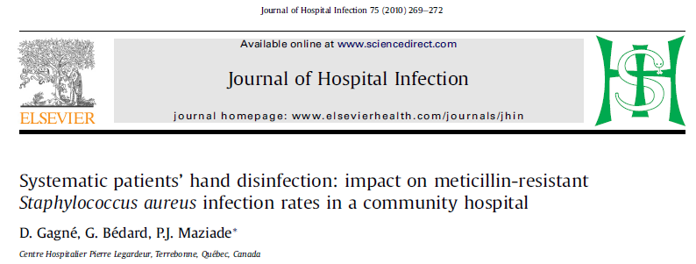

Slide 68
Does it Work?
Could not get MRSA rates down
4 full time and 4 part time attendants hired
Met patients and visiting relatives at door
Verbal and pamphlet
Encourage to clean hands at least twice per day
Used 70% with 0.5% Chlorhexidine

Slide 69
Results Impressive
 | 2002-3 | 2003-4 | Reduction
MRSA Infections per 1000 Admissions | 10.6 | 5.2 | 51%
MRSA BSI | 1.3 | 0.2 | 85%
MRSA Resp | 4.9 | 1.5 | 69%
Ratio MRSA BSI / MSSA BSI | 59% (13/22) | 14% (2/14) | 76%
MRSA Mortality | 0.7 | 0.2 | 71%
Notes:
PJMaziade: MRSA Infections: 2004-2005 2,3 cases/1000 adm , 2005-2006 1,0 case /1000adm , 2006-2007 0,6 case /1000 adm , 2007-2008 0,6 case /1000adm 2008-2009 0,7 case/1000adm , 2009-2010 0,5 case/1000adm, 2010-2011 0,3 case /1000adm , 2011-2012 0,2 case /1000 adm 2012-2013 0 case /1000 adm !!!
We have 16138 admissions in 2011-2012 and use 3100 liters/year of hand sanitizer At time of study ~10000 admissions per year

Slide 70
Projected Savings
$688,843!
May have prevented 51 infections
  MRSA infection ~ $14,360
  MRSA BSI ~ $27,083
  Staffing was $170,000
Notes:
Has continued project as standard of care

Slide 71
MRSA Infections per 1000 Patient Admissions
04-05 | 05-06 | 06-07 | 07-08 | 08-09 | 09-10 | 10-11 | 11-12 | 12-13
2.3 | 1.0 | 0.6 | 0.6 | 0.7 | 0.5 | 0.3 | 0.2 | 0
Personal Communication 2013

Slide 72
Patient Hand Hygiene
Assessment on admission for capability of performing hand hygiene
Do you know what this is?
Show me how to use it
Signage if not able to do own HH

Slide 73


Slide 74
Hand Sanitizer Bottle Label
FOR PATIENT USE
Keep on overbed table
If necessary, please ask for
assistance to use this product

Slide 75
Patient Moments
Landers 2012 (review)
1. After using the toilet, bedpan, or commode
3. Before eating, drinking, taking medicine, or putting anything in your mouth
Notes:
Another review article.

Slide 76
Patient Moments
4. When visibly dirty
5. Before touching any breaks in the skin (wounds, dressing, tubes) or any care procedure (dialysis, IV drug administration, injections)
7. After coughing, sneezing, or touching nose or mouth

Slide 77
Jim’s Additional Moments
Leaving a wheelchair
  - New pamphlet for patients
After pet therapy (Lefebvre 2006)

Slide 78
Control Measures
www.qualitysystems.com

Slide 79
Preventative Measures
Palmore 2013 - CRE
Patients use gloves and gowns
Double clean
Hand hygiene (staff)
Chlorhexidine baths (ICU)
Adherence monitoring
Notes:
“Two pumps, 20 seconds” was used widely in our hand hygiene campaign. Patients in enhanced contact isolation can leave their rooms only for medically necessary reasons, wear gowns and gloves when leaving the room, and are accompanied by staff members. Their visitors wear gowns and gloves at all times in patient rooms. Patients receive meals on disposable trays, using disposable dishes and utensils. Monitors were trained to handle friction from monitored individuals, but they encountered occasional conflicts, particularly when patient volume and acuity were high.
the room was double cleaned, disinfected with bleach, and decontaminated with hydrogen peroxide vapor before use by a patient

Slide 80
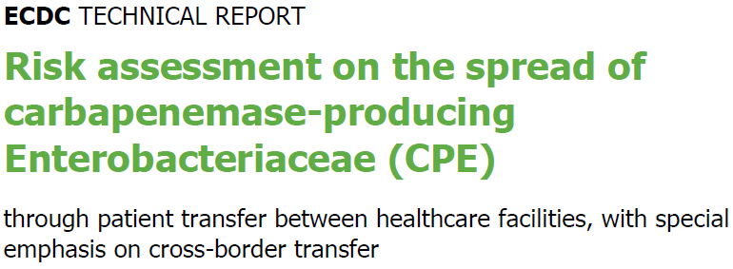
Guidelines
ECDC 2011

Slide 81

ECDC – Low Grade Evidence
…consistently supports the effectiveness of early, active surveillance for CPE carriage by rectal screening
Additional precautions for the care of CPE-positive patients,
  wearing disposable gloves and gown
  cohort nursing by a separate, dedicated team
Notes:
Systematic review of Infection Prevention and Control intervention studies. 6/7 active surveillance. 2 of 7 increased cleaning, 1 of 7 deep clean

Slide 82
ECDC – Other Measures
Long Term Healthcare Facilities
  Israel uses contact precautions if:
    Patient incontinent
    On antimicrobials
Notes:
Note This!

Slide 83
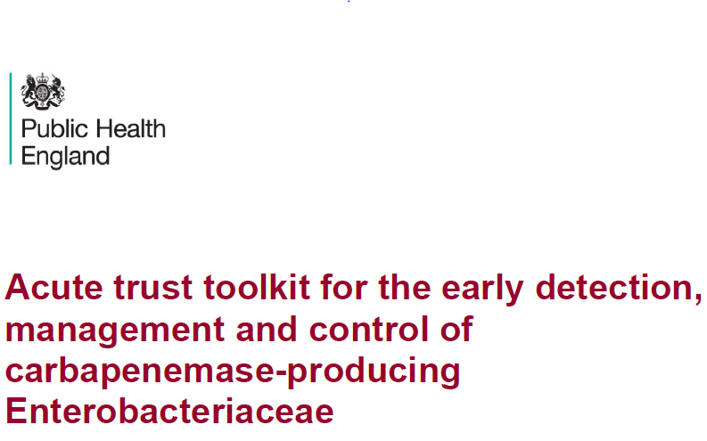
2013

Slide 84

PHE
Early Screening
Early Isolation
Reinforce Strict Standard Precautions

Slide 85
PHE
No words such as
  Bedpan
Does have language for
  Diarrhoea (around hand hygiene)
  Toilet (that patient will have a private en suite)
  Environment (cleaning)
  Commode (if no toilet)
  Disinfection (high touch, mattresses, endoscope, etc.)

Slide 86
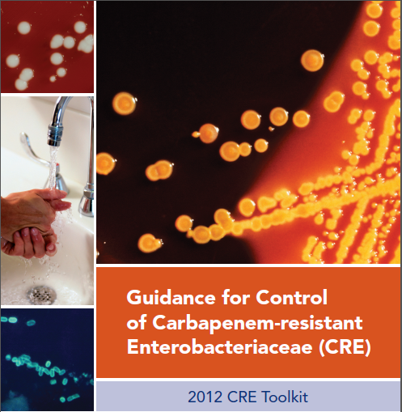

Slide 87

CDC
Hand Hygiene
Contact Precautions (colonized or infected)
Patient and staff cohorting
Minimize use of invasive devices
Antimicrobial Stewardship
Screening

Slide 88
CDC
LTC settings high risk residents
  totally dependent upon healthcare personnel for activities of daily living
  ventilator-dependent
  incontinent of stool
  wounds whose drainage is difficult to control
  high-risk settings (e.g., ventilator unit)
Notes:
Chlorhexidine Bathing
Chlorhexidine bathing has been used successfully to prevent certain types of healthcare-associated infections (e.g., bloodstream infections) and to decrease colonization with specific MDROs, primarily in ICUs. For CRE, it has been used as part of a multifaceted intervention to reduce the prevalence of CRE during an outbreak in a long-term acute care facility.

Slide 89
CRE Guidelines
Curran 2014
Confusion on terms like Standard Precautions
Ensure guidelines writers understand the front line
Notes:
A synopsis of the CPE challenge, An assessment of the strengths and weaknesses of the available guidance and toolkits, Guidance on developing a strategy to prevent CPE outbreaks

Slide 90
Curran 2014
5 Fronts:
  SP for all and additional transmission based precautions for CRE
  Hand washing basins free of CRE
  Safe injection and endoscopy practices
  Prepare for outbreaks
  Antimicrobial stewardship

Slide 91
Ebola
Feces and vomit have virus
  (Shieffelin 2014, Chertow 2014)
  Dallas family
    No illness
  Dallas hospital
    2 infected
Wet Phase
  2-4 litres of liquid stool per day

Slide 92
So, What do I Suggest?
Monitor, or know, how many patients are incontinent
  Or using briefs, diapers, assistive devices
Cochard 2014 – ESBL carriage nursing homes
Significantly associated with
  Malignancy
  Urinary AND fecal incontinence

Slide 93
Suggestions
When we publish, list how feces and urine is managed and by what percentage
  Brief/Incontinent product
  Toilet
  Commode
  AND
  Thermal disinfection
  Macerator
  Liner

Slide 94
Control Measures
www.qualitysystems.com

Slide 95
Suggestions
Manage feces and urine better than our great grandfathers
Mandate NO manual cleaning
  Thermal disinfection
  Macerators
  Liners
  Disposable

Slide 96
Suggestions
Mandatory gown use for any contact or potential contact with feces
  All the time
  Horizontal program
  Sporicidal agent for all terminal cleans of washrooms (Bengualid 2011, Galdys 2014)
  Use of UV for terminal clean of contact precaution room (Rutala, AHE conference 2016)
Notes:
We conclude that admission to an ICU room previously occupied by a patient with MDR P. aeruginosa or A. baumannii is an independent risk factor for acquisition of these bacteria by subsequent room occupants. This relationship was not identified for ESBL-producing GNB

Slide 97
Suggestions
Isolate patients with diarrhea
  Benjamin 2014
Any soiling of the environment with feces is an issue!
Spill clean up should include sporicide!?!

Slide 98
Suggestions
Lids on toilets/hoppers
  Aerosols around toilets from flushing has been studied (Gerba 1975, Barker 2005, Johnson 2013)
  C. difficile was in droplets around toilets with no lids (Best 2012, Roberts 2008)
  C. difficile detected on 31.6% of air vents (Wei 2017)
  Viral spread (Verani 2014)
Notes:
Barker Although a single flush reduced the level of micro-organisms in the toilet bowl water when contaminated at concentrations reflecting pathogen shedding, large numbers of micro-organisms persisted on the toilet bowl surface and in the bowl water which were disseminated into the air by further flushes.
Johnson Review article Research suggests that toilet plume could play a contributory role in the transmission of infectious diseases

Slide 99
Summary
It’s all about the poop…
Let’s talk about this!!

Slide 100
Comments? Questions?

Slide 101
References
Alasmari F, Sieler SM, Hink T, et al. Prevalence and risk factors for asymptomatic Clostridium difficile carriage. Clin Infect Dis 2014;59(2):216-22
American Practitioners in Infection Control and Epidemiology. http://www.apic.org/For-Consumers/Monthly-alerts-for-consumers/Article?id=cre-the-nightmare-bacteria. Accessed November 2, 2014
American Practitioners in Infection Control and Epidemiology. http://www.apic.org/For-Media/News-Releases/Article?id=2122443e-6d22-46ae-aecc-e9512e98e1cb Accessed November 10, 2014
Barker J, Jones MV. The potential spread of infection caused by aerosol contamination of surfaces after flushing a domestic toilet. J Appl Microbiol 2005;99:339-347

Slide 102
References
Benjamin A, Rogers BA, Havers SM, Harris-Brown TM, Paterson DL. Predictors of use of infection control precautions for multiresistant gram-negative bacilli in Australian hospitals: Analysis of a national survey. AJIC 2014;42:963-9
Best EL, Sandoe JAT, Wilcox MH. Potential for aerosolization of Clostridium difficile after flushing toilets: the role of toilet lids in reducing environmental contamination risk. J Hosp Infect 2012;80:1-5
Bengualid V, Umesh KC, Alapati J, Berger J. Clostridium difficile at a community hospital in the Bronx, New York: Incidence prevalence and risk factors from 2006 to 2008. AJIC 2011;39:183-7
Borgia S, Lastovetska O, Richardson D, Eshaghi A, et al. Outbreak of carbapenem-resistant Enterobacteriaceae containing blaNDM-1, Ontario, Canada. Clin Infect Dis. 2012 Dec;55(11):e109-17. doi: 10.1093/cid/cis737. Epub 2012 Sep 20.

Slide 103
References
Boyce JM, Havill NL, Otter JA, Adams NMT. Widespread environmental contamination associated with patients with diarrhea and methicillin-resistant Staphylococcus aureus colonization of the gastrointestinal tract. ICHE2007;28(10):1142-7
Cartmill TDI, et al. Management and control of a large outbreak of diarrhoea due to Clostridium difficile. J Hosp Infect 1994;27:1-15
Center for Disease Control and Prevention. Guidance for control of carbapenem-resistant Enterobacteriaceae (CRE). 2012 http://www.cdc.gov/hai/organisms/cre/cre-toolkit/index.html Accessed November 10, 2014
Chertow DS, Kleine C, Edwards JK, Scaini R, et al. Ebola virus disease in West Africa – clinical manifestations and management. NEJM 2014 Nov 5, 2014

Slide 104
References
Cochard H, Aubier B, Quentin R, van der Mee-Marquet N. Extended-spectrum beta lactamase-producing Enterobacteriaceae in French nursing homes: an association between high carriage rate among residents, environmental contamination, poor conformity with good hygiene practice, and putative resident-to-resident transmission. ICHE 2014;35(4):384-9
Curran ET, Otter JA. Outbreak column 15: Carbapenemase-producing Enterobacteriaceae. J Infect Prevent 2014;15:193-198
Donskey CJ, Kundrapu S, Deshpande A. Colonization versus carriage of Clostridium difficile. Infect Dis Clin N Am 2015;29:13–28
European Centre for Disease Prevention and Control. Risk assessment on the spread of carbapenemase-producing Enterobacteriaceae (CPE) through patient transfer between healthcare facilities, with special emphasis on cross-border transfer. Stockholm: ECDC;2011

Slide 105
References
Fekety R, et al. Studies on the epidemiology of antibiotic-associated Clostridium difficile colitis. Am J Clin Nutr 1980;33:2527-32
Gagné D, Bédard G, Maziade PJ. Systematic patients’ hand disinfection: impact on meticillin resistant Staphylococcus aureus infection rates in a community hospital. J Hosp Infect 2010;75:269-72
Galdys AL, Curry SR, Harrison LH. Asymptomatic Clostridium difficile colonization as a reservoir for Clostridium difficile infection. Expert Rev Anti Infect Ther 2014;12:967–80
Garcia R. A review of the possible role of oral and dental colonization of the occurrence of health care-associated pneumonia: underappreciated risk and a call for interventions. Am J Infect Control 2005;33(9):527-40

Slide 106
References
Gerba CP, Wallis C, Melnick JL. Microbiological hazards of household toilets: droplet production and the fate of residual organisms. Appl Microbiol 1975;30(2):229-237
Grabsch EA, Burrell LJ, Padiglione A, O’Keefe JM, et al. Risk of environmental and healthcare worker contamination with vancomycin resistant enterococci during outpatient procedures and hemodialysis. Infect Control Hosp Epidemiol 2006;27:287-93
Havill NL, Boyce JM, Otter JA. Extended survival of carbapenem-resistant Enterobacteriaceae on dry surfaces. ICHE 2014;35(4)445-7
Johnson DL, Mead KR, Lynch RA, Hirst DVL. Lifting the lid on toilet plume aerosol: A literature review with suggestions for future research. AJIC 2013;41:254-8
Landers T, Abusalem S, Coty MB, Bingham J. Patient-centered hand hygiene: the next step in infection prevention. AJIC 2012;40:S11-S17

Slide 107
References
Loo VG. Environmental interventions to control Clostridium difficile. Infect Dis Clin N Am 2015;29:83–91
Longtin Y, et al. Effect of Detecting and Isolating Clostridium difficile Carriers at Hospital Admission on the Incidence of C difficile Infections. A Quasi-Experimental Controlled Study. JAMA Intern Med. doi:10.1001/jamainternmed.2016.0177. Published online April 25, 2016.
Lyon GM, Mehta AK, Varkey JB, Brantly K, et al. Clinical care of two patients with Ebola virus disease in the United States. NEJM 2014 DOI: 10.1056/NEJMoa1409838
Mayer RA, et al. Role of fecal incontinence in contamination of the environment with vancomycin-resistant enterococci. Am J Infect Control 2003; 31:221-225.
McCoubrey J, et al. Clostridium difficile in a geriatric unit: a prospective epidemiological study employing a novel S-layer typing method. J.Med Micro 2003;52:573-8

Slide 108
References
National Audit Office. Reducing healthcare associated infections in hospitals in England. Report by the Comptroller and Auditor General. HC 560 Session 2008-2009; 2009. National Audit office; London, UK
Nseir S, Blazejewski C, Lubret R, Wallet F, et al. Risk of acquiring multidrug-resistant gram-negative bacilli from prior room occupants in the intensive care unit. Clin Microbiol Infect 2011;17:1201–1208
O’Donnell LJD, Virjee J, Heaton KW. Detection of pseudodiarrhea by simple clinical assessment of intestinal transit rate. BMJ 1990; 300(6772):439-40
Palmore TN, Henderson DK. Managing transmission for carbapenem-resistant Enterobacteriaceae in healthcare settings: a view from the trenches. Clin Infect Disease 2013;57(11):1593-9
Public Health England Working Group. Acute trust tooklit for the early detection, management and control of carbapenemase producing Enterobacteriaceae. 2013 PHE: London.

Slide 109
References
Ray AJ, et al. Nosocomial transmission of vancomycin-resistant enterococci from surfaces. J Am Med Assoc 2002;287:1400-1401
Roberts K, Smith FC, Snelling AM, Kerr KG, et al. Aerial dissemination of Clostridium difficile spores. BMC Infect Dis 2008;8:7
Sattar S, Maillard JY. The crucial role of wiping in decontamination of high-touch environmental surfaces: Review of current status and directions for the future. Am J Infect Control 2013;41:S97-S104
Savage J, Fuller C, Besser S, Stone S. Use of alcohol hand rub (AHR) at ward entrances and use of soap and AHR by patients and visitors: a study in 27 wards in 9 acute NHS trusts. J Infect Prev 2011;12:54-8
Schieffelin JS, Shaffer JG, Gova A, Gbaki M, et al. Clinical illness and outcomes in patients with Ebola in Sierra Leone. NEJM.org Oct 29 2014. DOI: 10.1056/NEJMoa1411680

Slide 110
References
Siani G, Cooper C, Maillard JY. Efficacy of “sporicidal” wipes against Clostridium difficile. Am J Infect Control 2011;39:212-8
Tängdén T, Cars O, Melhus A, Löwdin E. Foreign travel is a major risk factor for colonization with Escherichia coli producing CTX-M-type extended-spectrum beta-lactamases: a prospective study with Swedish volunteers. Antimicrob Agents Chemother 2010; 54:3564–8 Verani M, Bigazzi R, Carducci A. Viral contamination of aerosol and surfaces through toilet use in health care and other settings. AJIC 2014;42:758-62
Walsh TR, Weeks J, Livermore DM, Toleman MA. Dissemination of NDM-1 positive bacteria in the New Delhi environment and its implications for human health: an environmental point prevalence study. The Lancet Infect Dis 2011;11:355-62

Slide 111
References
Wenzel RP, Edmond MB. Infection control: the case for horizontal rather than vertical interventional programs. Int J Infect Dis 2010;14(supp 4);S3-S5
Yui S, Ali S, Muzslay M, et al. Identification of Clostridium difficile reservoirs in the patient environment and efficacy of aerial hydrogen peroxide decontamination. ICHE 2017;38(12):1487-92
Zoutman DE, Ford BD, Sopha K. Working relationships of infection prevention and control programs and environmental services and associations with antibiotic-resistant organisms in Canadian acute care hospitals. AJIC 2014;42:349-52
Zoutman DE, Ford BD, Sopha K. Environmental cleaning resources and activities in Canadian acute care hospitals. AJIC 2014;42:490-494

Slide 112
References
Ali S, et al. Effect of surface coating and finish upon the cleanability of bed rails and the spread of Staphylococcus aureus. J Hosp Infect 2012;80:192-8
Adams CE, et al. Examining the association between surface bioburden and frequently touched sites in the intensive care. J Hosp Infect 2017;95:76-80.
Attaway HH, et al. Intrinsic bacterial burden associated with intensive care unit hospital beds: effects of disinfection on population recovery and mitigation of potential infection risk. AJIC 2012;40:907-12
Bhalla A, et al. Acquisition of nosocomial pathogens on hands after contact with environmental surfaces near hospitalized patients. ICHE 2004;25:164-167.
Bonten MJM, et al. Epidemiology of colonisation of patients and environment with vancomycin-resistant enterococci. Lancet 1996;348:1615-1619.

Slide 113
References
Boyce JM, et al Outbreak of multidrug-resistant Enterococcus faecium with transferable vanB class vancomycin resistance. J Clin Microbiol 1994;32:1148-1153.
Boyce JM, et al. Widespread environmental contamination associated with patients with diarrhea and methicillin-resistant Staphylococcus aureus colonization of the gastrointestinal tract. ICHE 2007;28(10):1142-7.
Calfee DP, et al. Strategies to prevent methicillin-resistant Staphylococcus aureus transmission and infection in acute care hospitals: 2014 Update ICHE 2014;35(S2):S108-132
Choi WS, et al. Acinetobacter baumanii in intensive care units and successful outbreak control program. J Korean Med Sci 2010;25:999-1004.

Slide 114
References
Cobley M, et al. Environmental contamination during tracheal suction. Anaesthesia 1991;46:957-61.
Cohen, et. al., Frequency of patient contact with health care personnel and visitors: implications for infection prevention. Jt Comm J Qual Patient Safety, 2012; 38 (12): 560-565
Dancer SJ, et al. Monitoring environmental cleanliness on two surgical wards. Int J Environ Health Res 2008;18:357-364.
Dancer SJ, et al. Measuring the effect of enhanced cleaning in a UK hospital: a prospective cross-over study. BMC Med 2009;7:28.
Duckro AN, et al. Transfer of vancomycin-resistant enterococci via health care worker hands. Arch Intern Med 2005;165:302-307.

Slide 115
References
Enfield KB, et al. Control of simultaneous outbreaks of carbapenemase-producing Enterobacteriaceae and extensively drug-resistant Acinetobacter baumannii infection in an intensive care unit using interventions promoted in the Centers for Disease Control and Prevention 2012 carbapenemase resistant Enterobacteriaceae toolkit. ICHE 2014;35:810-817.
Hayden MK, et al. Reduction in acquisition of vancomycin-resistant Enterococcus after enforcement of routine environmental cleaning measures. Clin Infect Dis 2006;42:1552-1560.
Hess AS, et al. A randomized controlled trial of enhanced cleaning to reduce contamination of healthcare worker gowns and gloves with multidrug-resistant bacteria. ICHE 2013;34:487–493.

Slide 116
References
Hota B, et al. Interventional evaluation of environmental contamination by vancomycin-resistant enterococci: failure of personnel, product, or procedure? J Hosp Infect 2009;71:123-31.
Huslage, K et al. A Quantitative approach to defining “high‐touch” surfaces in hospitals. ICHE 2010;31(8):850-3
Johnson D, et al. Patients’ bath basins as potential sources of infection: a multicenter sampling study. Am J Crit Care 2009;18(1):31-40.
Kelly CP, et al. Clostridium difficile colitis. NEJM 1944;330(4):257-62
Lamont RJ, Jenkinson H. In: Oral microbiology at a glance. Wiley-Blackwell 2010. West Sussex UK

Slide 117
References
Mayer RA, et al. Role of fecal incontinence in contamination of the environment with vancomycin-resistant enterococci. AJIC 2003; 31:221-225.
Morgan DJ, et al. Frequent multidrug-resistant Acinetobacter baumannii contamination of gloves, and hands of healthcare workers. ICHE 2010;31(7):716–721.
Morgan DJ, et al. Transfer of multidrug-resistant bacteria to healthcare workers’ gloves and gowns after patient contact increases with environmental contamination. Crit Care Med 2012;40(4):1045–1051.
Otter JA, et al. The role played by contaminated surfaces in the transmission of nosocomial pathogens. ICHE 2011;32(7):687-99.

Slide 118
References
Ray AJ, et al. Nosocomial transmission of vancomycin-resistant enterococci from surfaces. JAMA 2002;287:1400-1401.
Rock C, et al. Frequency of Klebsiella pneumoniae Carbapenemase (KPC)–producing and non-KPC producing Klebsiella species contamination of healthcare workers and the environment. ICHE 2014;35(4):426-9
Rose JB, et al. Pathogens in graywater from various household sources. Wat Res 1991;25(1):37-42.
Sample ML, et al. An outbreak of vancomycin-resistant enterococci in a hematology-oncology unit: control by patient cohorting and terminal cleaning of the environment. ICHE 2002;23:468-470.

Slide 119
References
Sehulster LM, et al. Guidelines for environmental infection control in health-care facilities. Recommendations from CDC and the Healthcare Infection Control Practices Advisory Committee (HICPAC). https://www.cdc.gov/infectioncontrol/pdf/guidelines/environmental-guidelines.pdf Accessed 20180131
Thom KA, et al. Environmental contamination because of multidrug-resistant Acinetobacter baumannii surrounding colonized or infected patients. AJIC 2011;39:711–715.
Yui S, et al. Identification of Clostridium difficile reservoirs in the patient environment and efficacy of aerial hydrogen peroxide decontamination. ICHE 2017;38(12):1487-92

Slide 120
References
Zelechowski GP. Suction collection and its relation to nosocomial infection. AJIC 1980;8(1):22-5
Jinadatha C, et al Interaction of healthcare worker hands and portable medical equipment: a sequence analysis to show potential transmission opportunities. BCM Infect Dis 2017;17:800

